Slide 1
VR Application Research & Design Team 5
Daniel Johnson | Asad Ashur | T. Avery Eich
Advisor: Dr. Aleshia Hayes
Notes:
“Hello everyone, my name is Daniel J., I’m the team leader for design group 5. I worked mainly as a coordinator, communicating with Dr. Hayes, and did most of the code work involved with the project.

Slide 2
Project Schedule
Phase | Start | End | Hours
Research | 12 | 10 | 22
Design | 12 | 13 | 25
Prototype | 0 | 14 | 14
Meeting Time | 60 | 66 | 126
Total hours spent :
Notes:
Our time during this course sequence was split up into three main phases, a research phase, design phase, and prototype development phase.

Slide 3
Presentation Outline
Introduction
System Design
Prototype Demonstration
Remarks
Notes:
I’ll introduce the project vision, then we will give a brief overview of each of the development phases, and finally wrap up with some concluding remarks on the outcome of the project.

Slide 4
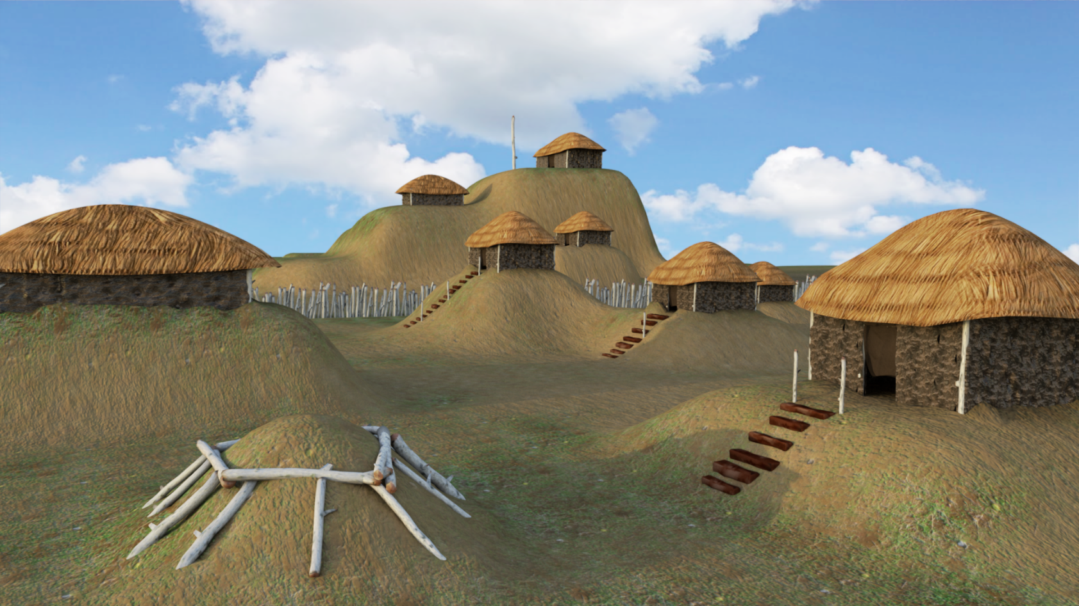
Introduction
Simulation using Unity Engine
Notes:
“This project aimed to give a unique opportunity to a design team, to work collaboratively on a creative project that spans both computer science and visual communication. This is important to not only myself, but also to Dr. Hayes and Dr. Andres Montenegro in VCD, because projects like this are not traditionally available to either department alone.”
“The research from last semester directed the design of a real time strategy, cultural simulation experience inspired by the North American, Mississippian cultural period (“Mound Builders”). Asad is going to describe for you the map architecture, and then Avery will present the system of resource gathering and asset production.

Slide 5
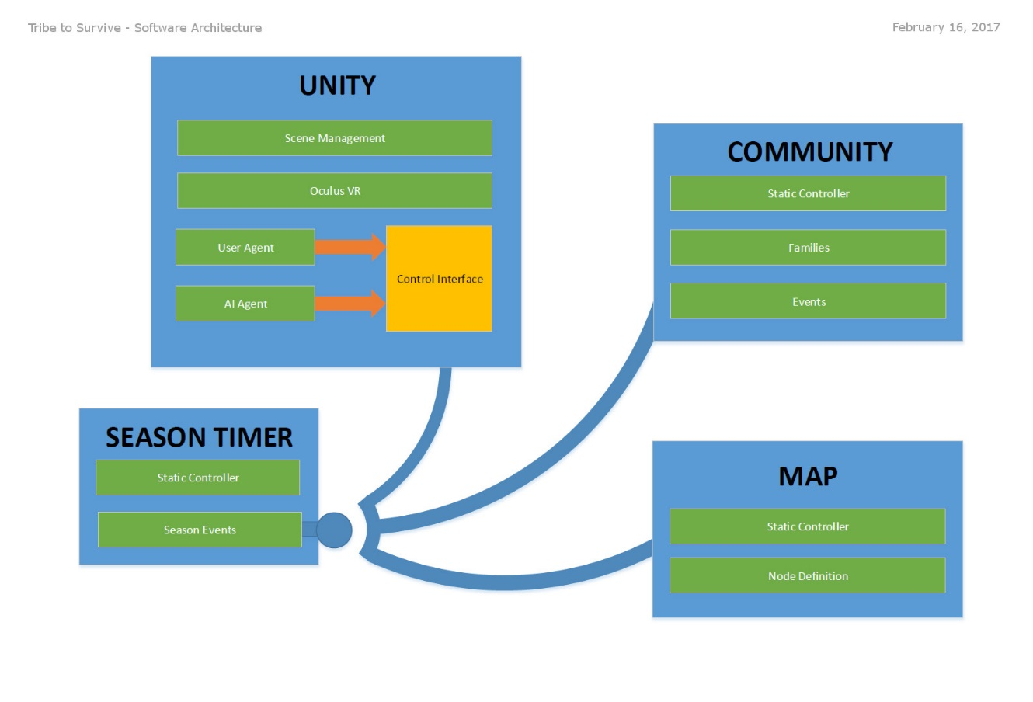
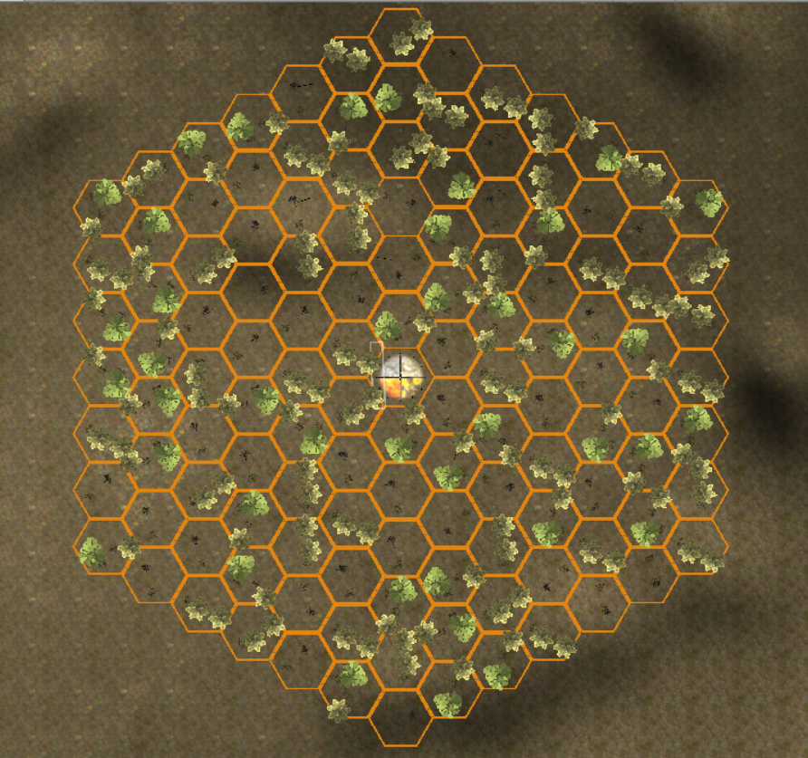
Map Architecture
Notes:
“Hello, my name is Asad Ashur – I worked mainly on collecting and organizing the VR research data on this project, and assisted with the application architecture development.”
“A prototype system was developed using the Unity Game Engine, and tested on a mobile VR device (Samsung Gear VR). Cultural details were modeled in our system architecture, including family units and economic activities. To visualize the community, a dynamic map structure was created to track the placement and state of game elements.”

Slide 6
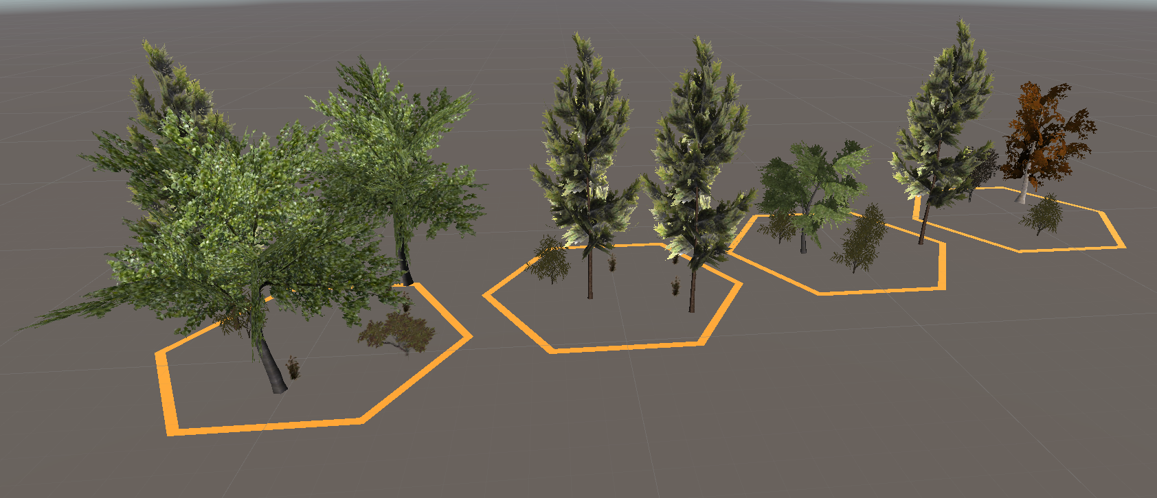
Map Nodes
Notes:
The map is made of nodes, shown here, used to create the map overview environment.
Each prefab was created by grouping multiple objects together, including scripts that allow the Unity Engine to manage each node.
The map is generated by randomly choosing and rotating one of these prefabs for each node.

Slide 7
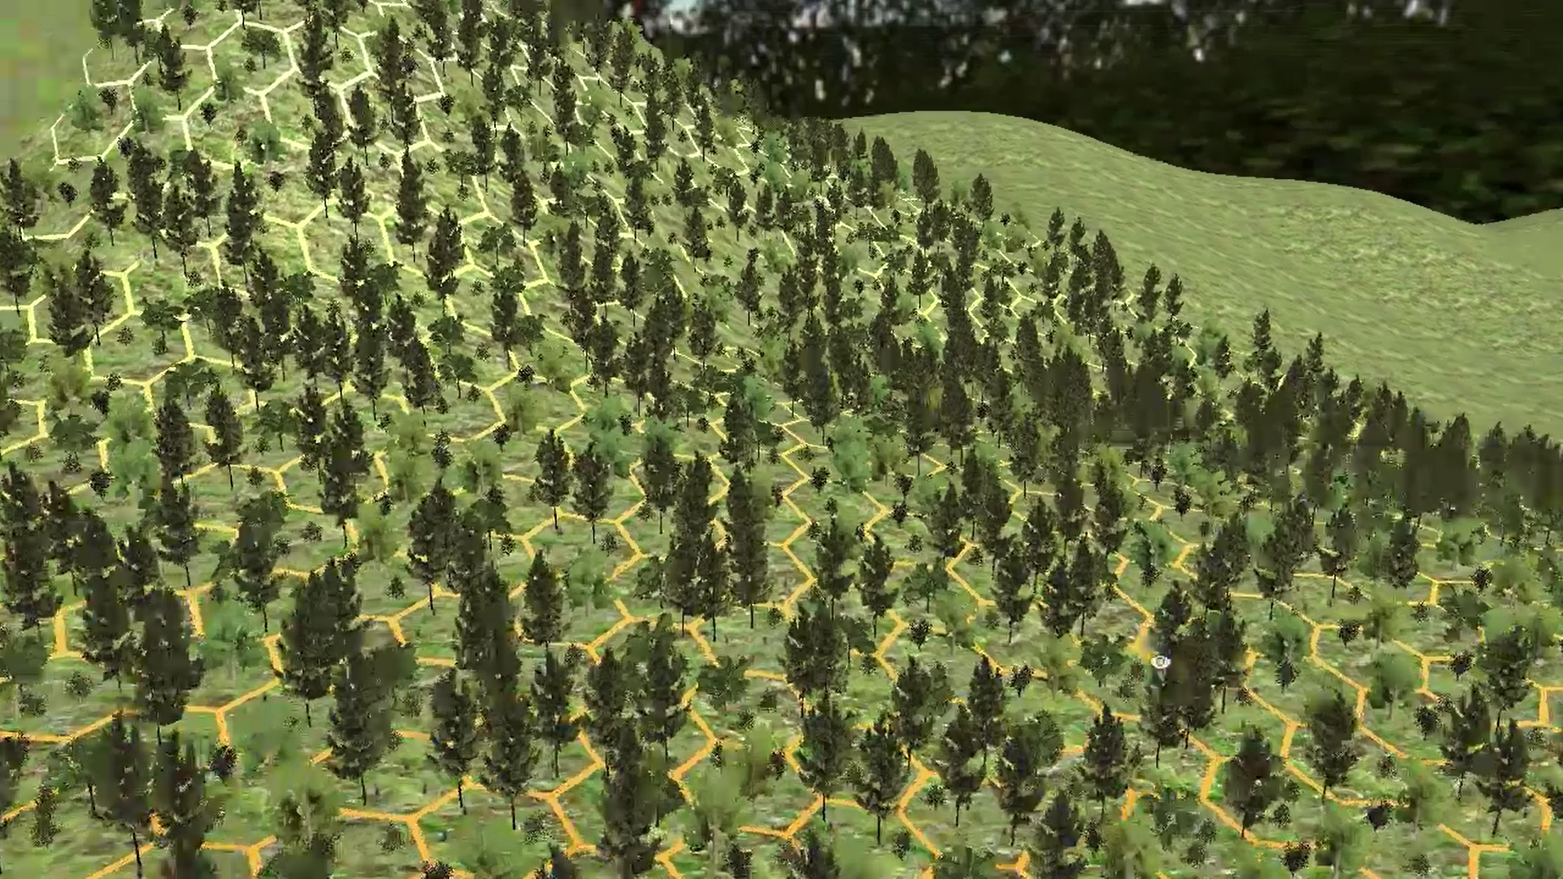
Random Map Generation
Notes:
Each node is hexagonal, and it has a reference to all other 6 nodes around it.
All the nodes are stored in a linked list so that each node has information about the surrounding nodes. This helps us keep track of the state of game objects when we are adding, removing, or changing them.

Slide 8
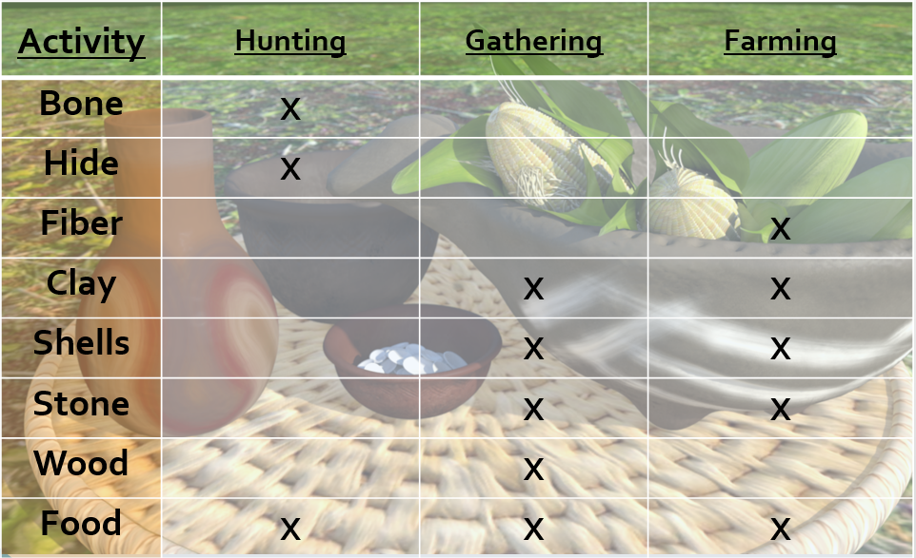
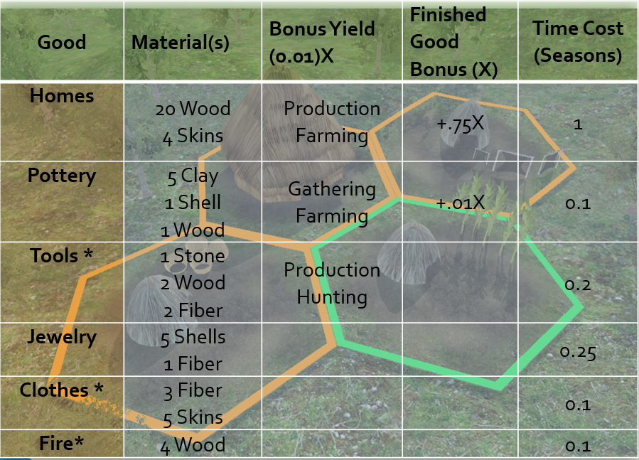
Resource Gathering & Production
Raw Material Gathering
Finished Good Effect(s)
Notes:
“Hello, my name is Avery Eich. I worked on researching archaeological details to formulate our technical design document.
​
We used historical research to develop this system that creates a tokenized economy based on the Mound Builders. Each item is chosen to maximize the inclusion of the thousands of disparate materials manufactured. From the raw good, finished goods are produced, which each increase the yield of different activities. For example, the more baskets a family produces, the more effective their gathering skill.

Slide 9
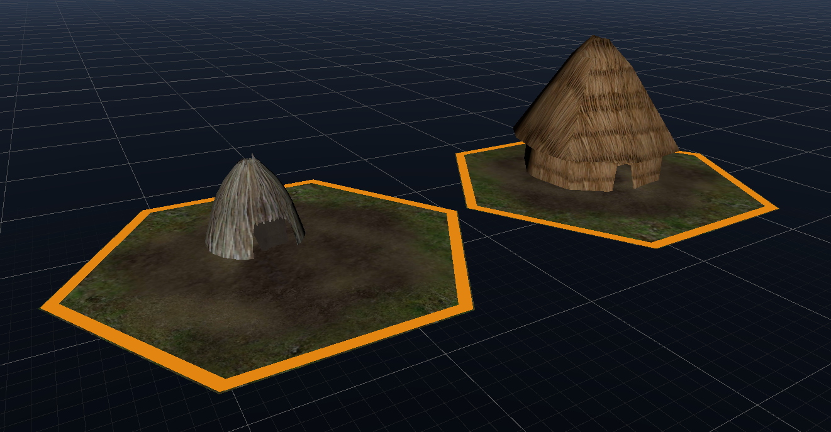
“Home” Nodes
Notes:
To show family location on the map, we have two different “family nodes.” One shows the first, or main, family location, and as homes are built for the family, secondary homes are placed next to the main home. These placements eventually form cities which aren't representative of archeological examples, but some basic features resonate. The biggest similarity may be a lack of trees near the main city grounds, as eventually every source is scoured over centuries.

Slide 10
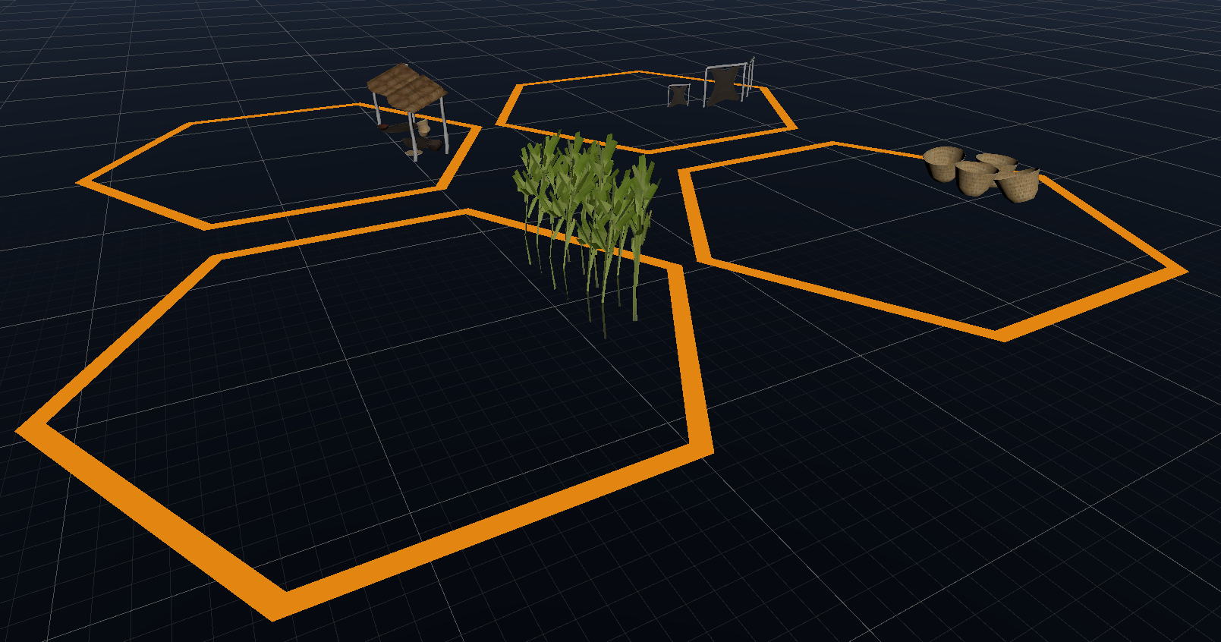
“Activity” Nodes
Notes:
Each home is then assigned an activity, hunting, gathering, farming, or production. Each has their own supplemental (supporting) node that is placed on top of the home node to show which activity the home is participating in.

Slide 11
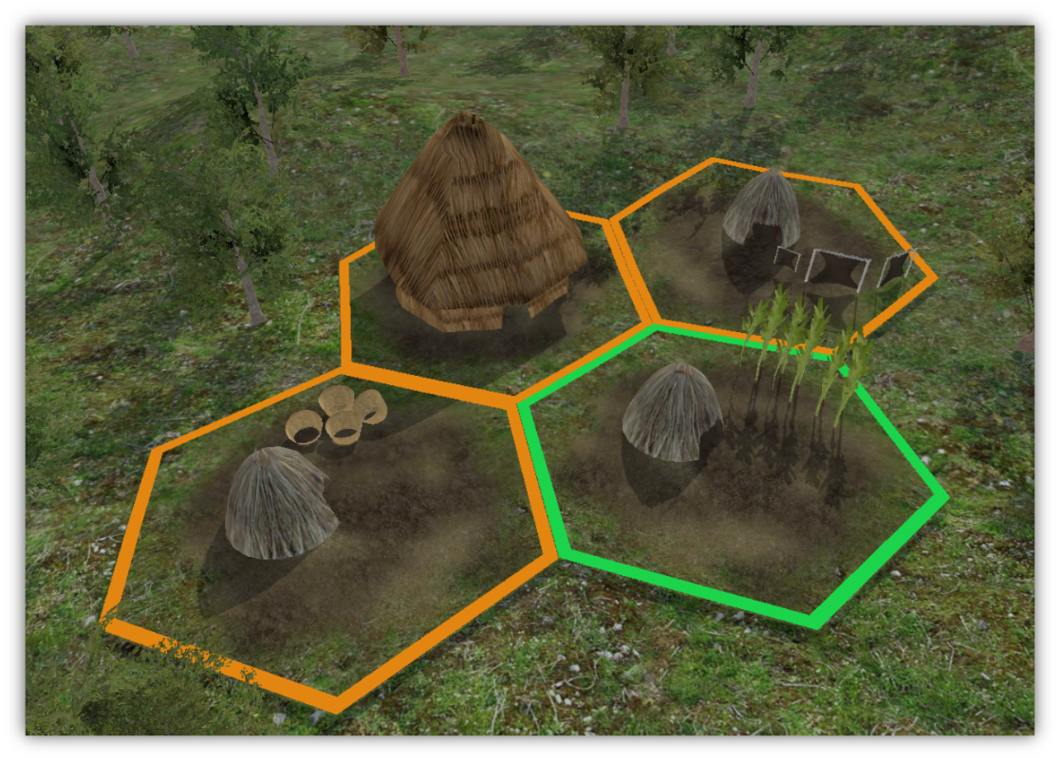
Family “Unit”
Notes:
All together, the environment is adorned with huts as new families extend lines and excel at their crafts over the years. Just the models caught in the requisite arrangement, most families either have their tasks chosen by the player or randomly selected. This family unit had no choice.

Slide 12

Progression
Notes:
“So here we have our first working demo, just to see the numbers going back and forth. So each family there, group of houses, has their stats. so based on the household activity, like hunting -- that household is hunting. So based on your household activities, each season the family gains the raw materials associated with the activity. So the UI there is there to show us how the numbers are going up.”
“The system was designed to be offered as a cultural simulation that would progress without any user interaction using randomly generated events and basic AI decision-making. However, a user is given the choice of observing the community at various levels, or even participating in economic activities such as hunting, gathering, or farming.”

Slide 13
Remarks
Virtual Reality is Practical
Entertainment
Education
Training/Simulation
Departmental Collaboration
Creative “pipeline”
Team-oriented development
Communication
Notes:
“Our team discovered that Virtual Reality application design and development is a new frontier that has a mysterious future. The technology holds great potential for use in entertainment, education and job training. This project granted team members valuable insight into unique system design and collaboration between software engineering and visual communication. Obviously, our team wasn’t able to develop a fully-functioning system, but we did learn a lot about the research, design, and prototyping phases of software engineering.”

